Slide 1
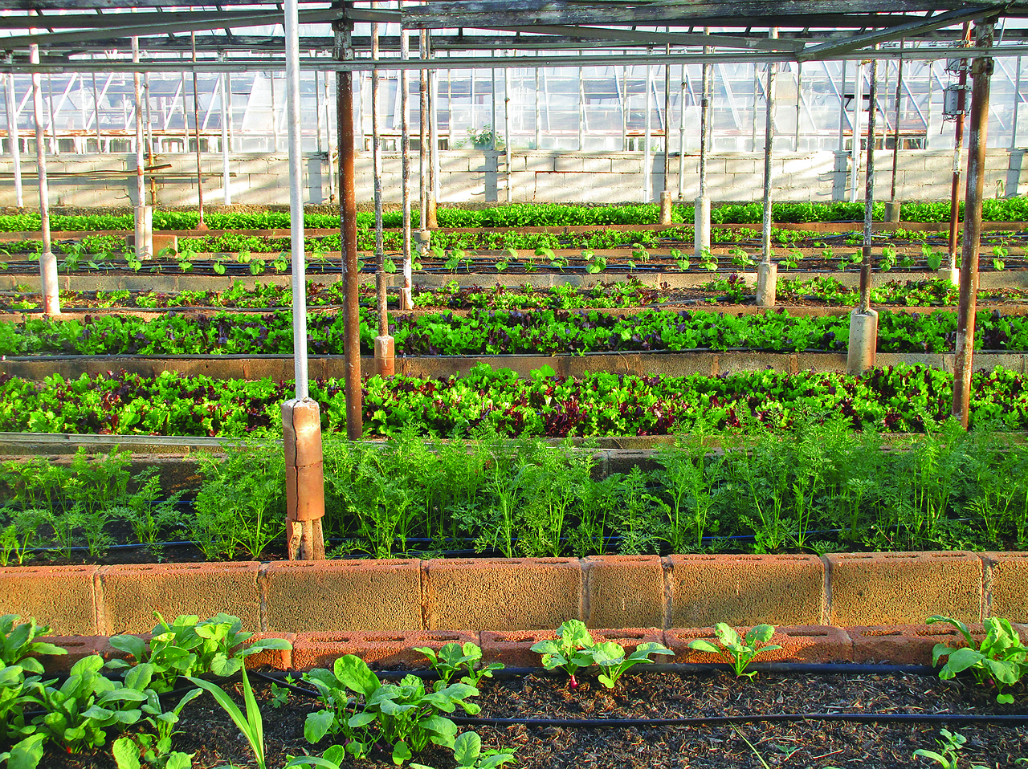
IoT Project On,
Wireless Controllable Green House
By, Team 1

Slide 2
Team Members Section – 6CSE4
Hadke Jayesh Rajendra 20191CSE0180
Harsh Kumar Yadav 20191CSE0186
Harshit S M 20191CSE0189
Harshita Harish 20191CSE0191
Kanishka Joshi 20191CSE0235

Slide 3
What is Greenhouse and Why do we need?
A greenhouse (also called a glasshouse, or, if with sufficient heating, a hothouse) is a structure with walls and roof made chiefly of transparent material, such as glass, in which plants requiring regulated climatic conditions are grown.
A miniature greenhouse is known as a cold frame. The interior of a greenhouse exposed to sunlight becomes significantly warmer than the external temperature, protecting its contents in cold weather.

Slide 4
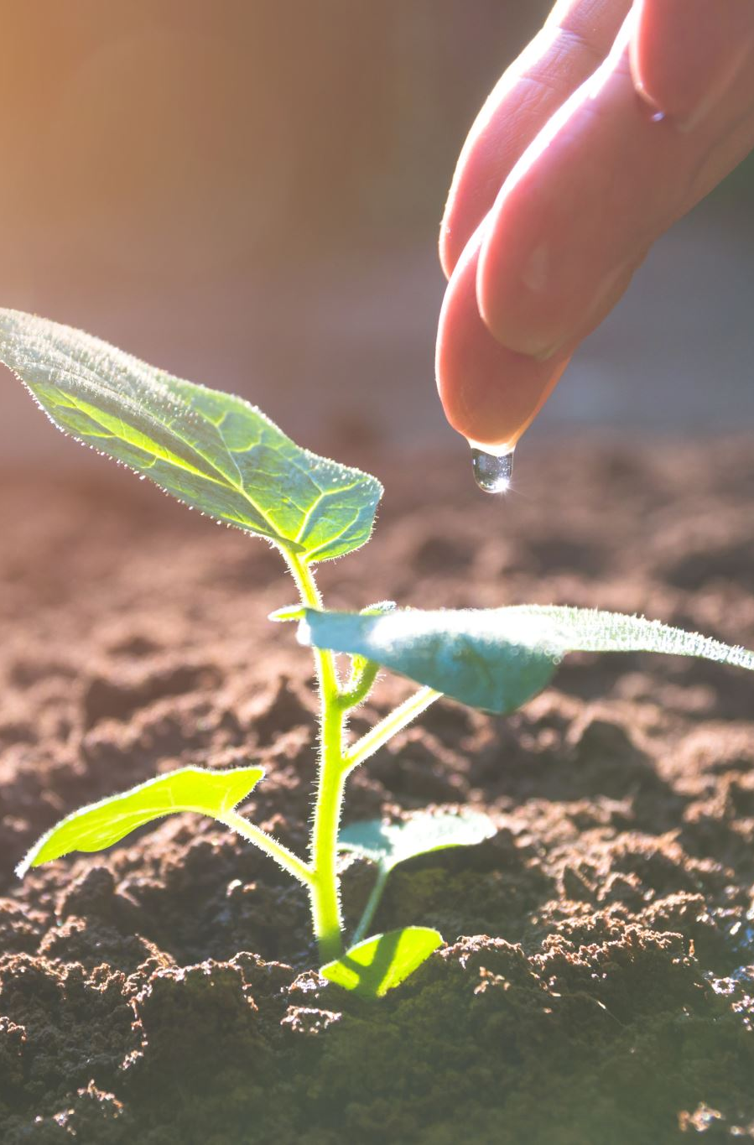
What’s new Now?
Control Your Greenhouse remotely from anywhere
Water Supply by Humidity of Soil
Air Flow Control
Check Current Humidity & Temperature

Slide 5
Components Use
ESP32 (instead of Arduino) Rs. 400.0
Humidity & Temperature Sensor (DHT 11) Rs. 100.0
Soil Humidity Sensor Rs. 55.0
Water Pumps Rs. 60.0
L298 Motor Driver Rs. 125.0
Ventilation Fan Rs. 50.0
Relay Rs. 65.0
Other Rs. 200.0
Total: 1100.0 (approx.)

Slide 6
How does it Work?
ESP32 has an integrated Wi-Fi and Bluetooth Module and can work as Arduino with a greater number of pins.
All the Sensors and Actuators will connect to ESP32 and ESP32 will send all the data to the Centralized Database (in our case, it’s Firebase), which similarly can fetch data from the database.
An android app will fetch data from the database and can send data to the database, and according to the data shared from the android app, an ESP32 will act by fetching data from the database.

Slide 7
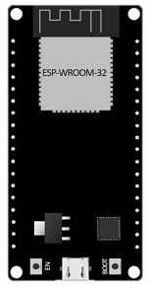


Centralized Database System Architecture

Slide 8
Future Scope
NPK Sensor can be used and according to soil conditions, nutrient water can be passed through a pipe.
Air Quality Sensor use to check air quality and Air Purifier can use to maintain appropriate air in a container.
A high-Definition Camera can use to analyze the growth of plants and the condition of plants with help of AI.

Slide 9
Thank You!

